Slide 1
Lecture 19 October 18, 2019
Exam 2 Returned today.
Great job in lab!---Our cv, y, f flies should be emerging next week---so be prepared to do some independent work in the lab. Instructions coming.

Slide 2
Where were we?....
Extensions of Mendel’s observations…
Blood type rbc antigen antibody produced result as transfusion recipient
A A anti-B agglutinates B RBCs
B B anti-A agglutinates A RBCs
AB A and B none no agglutination
O no A nor B anti-A and anti-B agglutinates A, B, AB RBCs

Slide 3
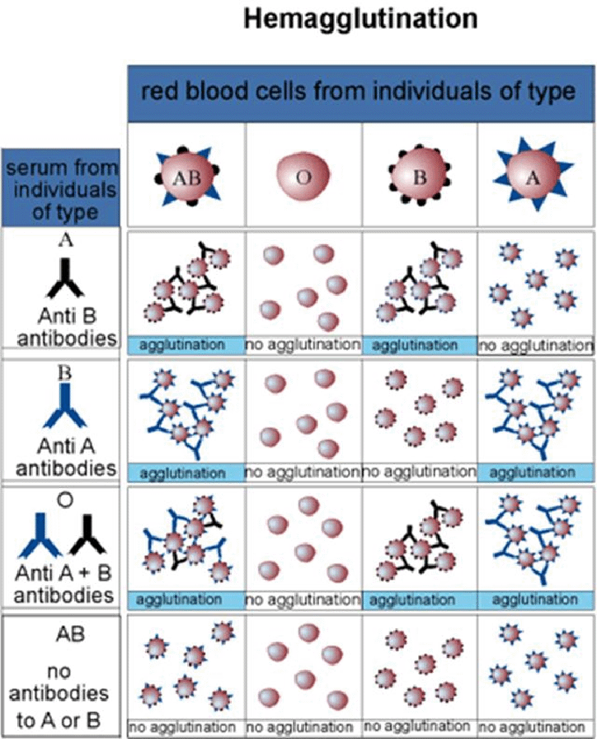

Slide 4
Try the blood typing game at: Nobelprize.org
http://www.nobelprize.org/educational/medicine/bloodtypinggame/

Slide 5
Rh incompatibility
Rh-negative mother conceives an Rh-positive child.
Normally blood from fetus and mother never comes in direct contact because of the placenta
At birth, however, placenta often ruptures and fetal rbcs may enter the mother’s circulation
Mother, who lacks Rh antigen sees it as “foreign” and begins to make anti Rh-antibodies. These antibodies can lyse/destroy rbcs with Rh antigen on them.

Slide 6
(more) Extension #4
Genes with multiple alleles (examples)
I gene (A, B, O) alleles
White gene (locus) in Drosophila (100+ alleles which give variation to the wild-type (brick red) color). Variation at this gene gives possibility of many different eye colors/patterns.

Slide 7
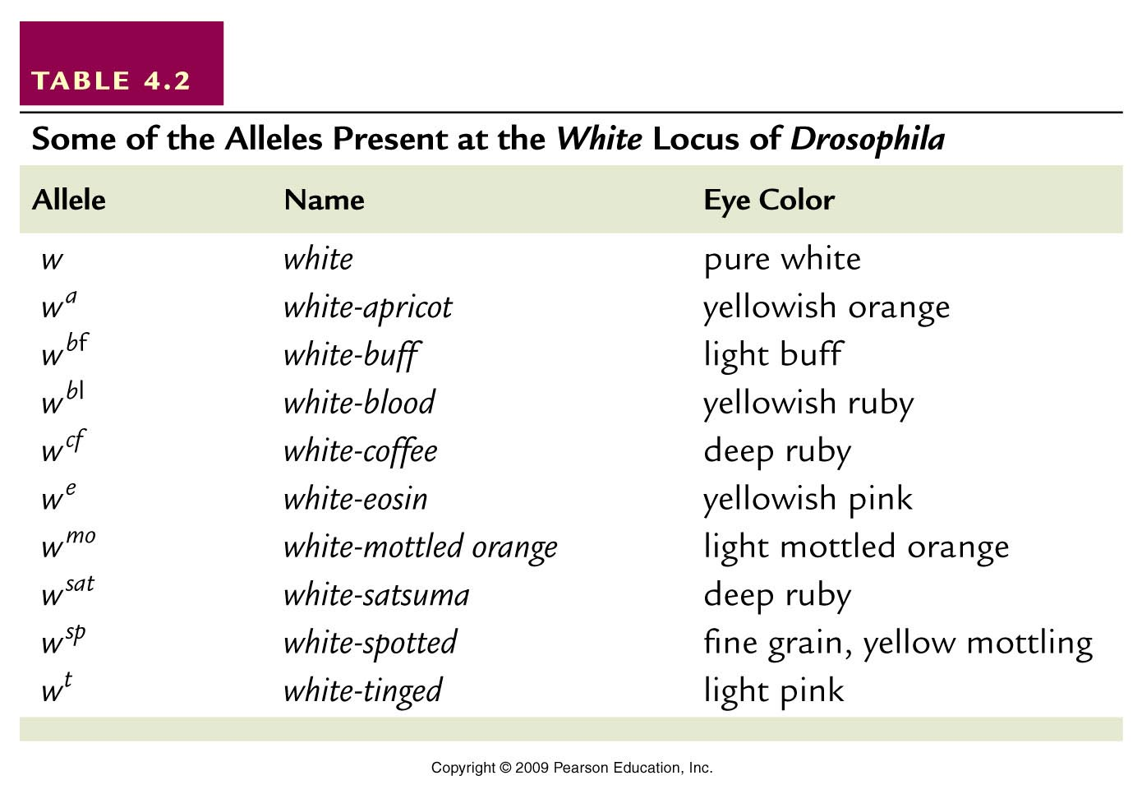
Table 4.2
Notes:
Table 4.2 Some of the Alleles Present at the white Locus of Drosophila

Slide 8
White-apricot, white-blood, white-eosin

Slide 9
What is happening at the molecular level?…
Drosophila chromosome 4/(X)
White gene locus
Gene has been altered (mutated ) multiple times over time, resulting in many variations in a protein that controls eye color.
X

Slide 10
A gene in mammals also shows 100s of alleles
Major histocompatability complex (MHC)
Gene encoding a protein needed for immune responses.
Shows such variability to allow the population to effectively deal with many pathogens
Gene is so variable (polymorphic) that few unrelated people share the same MHC genotype. (Virtually everyone is a heterozygote).

Slide 11
Why do we care about MHC?...
Important in normal immunity
We have discovered it is reason that tissue transplants fail. Some MHC proteins must be identical for the recipient to accept donated tissue.
“tissue match” is really MHC match.
Why do we often arrange tissue transplants with family members?...

Slide 12
Think of just one MHC gene Theoretically, you could match your siblings. You have a 25% chance of matching one of your siblings (4 unique genotypes).

Slide 13
The need for unrelated donors…for organs, including bone marrow (Next semester--- bone marrow registry drive)

Slide 14
Extension #5
Lethal alleles
In some matings we may see non-Mendelian ratios if some of the offspring fail to survive development.

Slide 15
Indicates that the gene in question encodes something essential for survival

Slide 16
noted in an interesting cross of mice with variation in fur color…
Wild type color= agouti (yellow pigment deposited on a black hair shaft)
Wild type allele=A
Dominant mutation (A^{y}) results in yellow fur.
What do you expect in a cross of 2 yellow mice (heterozygotes)? A A^{y} X A A^{y}

Slide 17
 | A | A^{y}
A | AA | AA^{y}
A^{y} | AA^{y} | A^{y}A^{y}
Expect?...3 yellow: 1 agouti

Slide 18
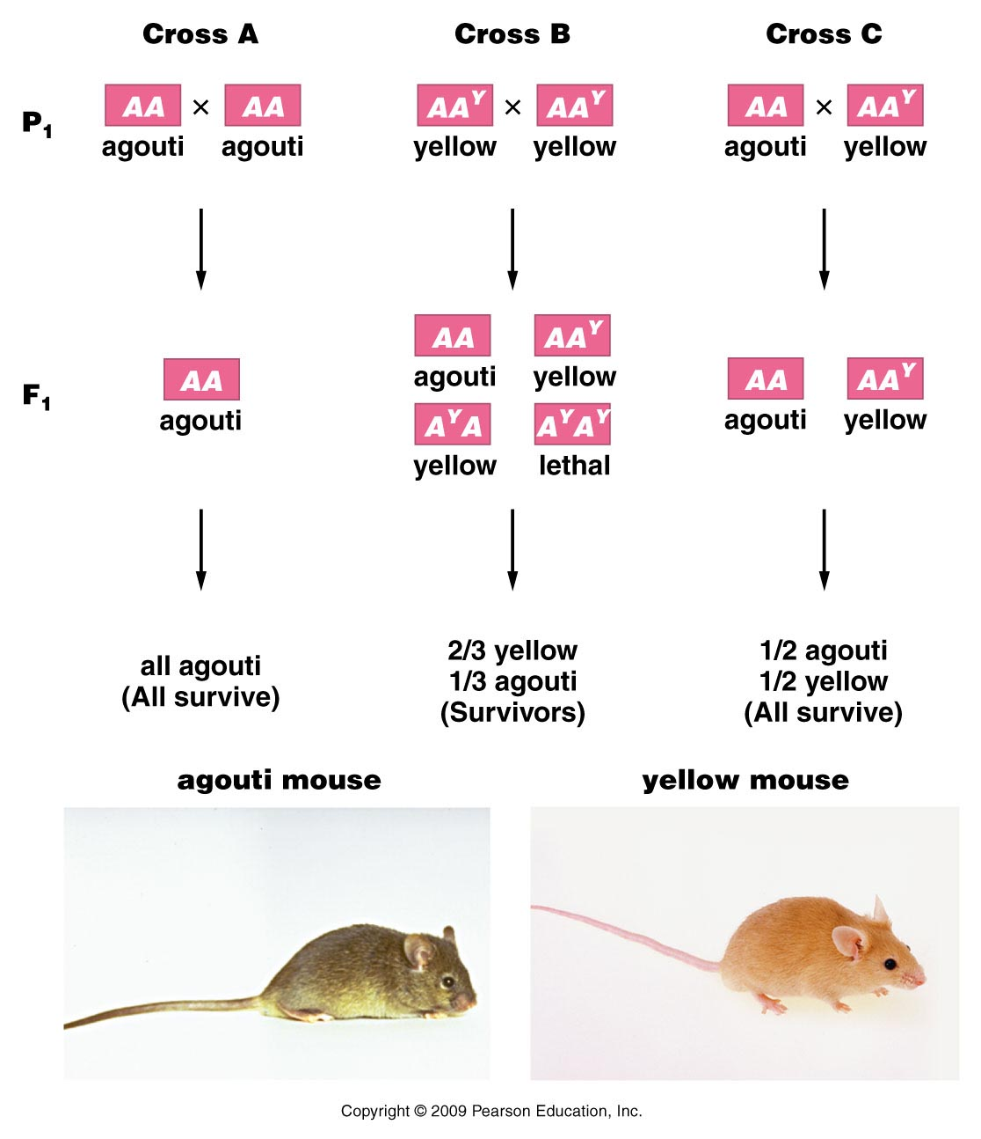
Figure 4.4
Notes:
Figure 4-4 Inheritance patterns in three crosses involving the normal wild-type agouti allele (A) and the mutant yellow allele (A^{Y}) in the mouse. Note that the mutant allele behaves dominantly to the normal allele in controlling coat color, but it also behaves as a homozygous recessive lethal allele. The genotype A^{Y} A^{Y} does not survive.

Slide 19
observe~2 yellow:1 agouti
Explanation…looks like the A^{y} A^{y} genotype which we expect to be yellow, is also a lethal genotype.
(A^{y} is called a recessive lethal allele). Mice with this genotype die before they are born. They are not observed in the offspring.

Slide 20
Molecular mechanism?...
Nothing to do with yellow fur!
Y mutation/allele is really a large deletion of a chromosome region (which affects regulation of yellow pigmentation)
AND.. which affects the nearby gene called merc. The merc gene product is essential for normal development—so in A^{y} A^{y} mice, the wild type merc alleles are lost in both chromosomes.

Slide 21
Lethal alleles…
Can be recessive or dominant
Recessive A^{y} A^{y}
Dominant (Huntington allele) Hh—get Huntington disease and eventually die from it
Can be expressed before or after birth (A^{y} A^{y} is embryonic lethal; Hh is lethal in adulthood)

Slide 22
Extension #5
Traits controlled by 2 or more genes.
Drosophila eye color
ABO blood type (we didn’t tell the whole story!)
Labrador retriever color
Many more!!!

Slide 23
When a trait is controlled by more than one gene, we have to consider genotypes at 2+ loci to determine a single phenotype.

Slide 24
Start with something familiar…
ABO blood type.

Slide 25
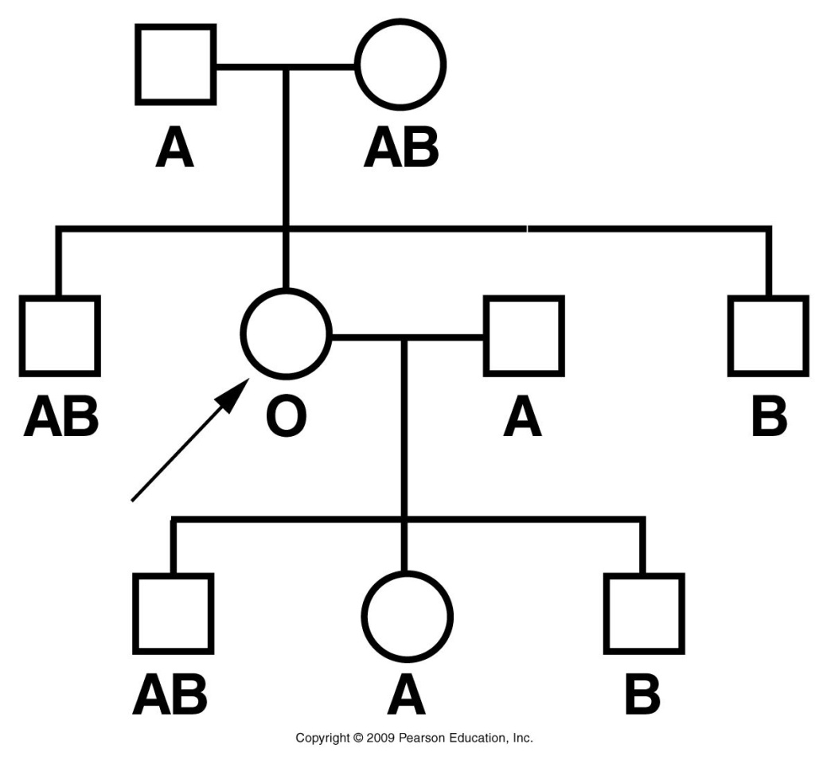
What is wrong with this pedigree? Explain every inconsistency.
Figure 4.3
Notes:
Figure 4-3 A partial pedigree of a woman displaying the Bombay phenotype. Functionally, her ABO blood group behaves as type O. Genetically, she is type B.

Slide 26
Proband—a woman in Bombay ( now called Mumbai) India.
Blood testing showed no A or B antigens on her rbc, despite having parents A and AB.
She had a son and daughter who clearly inherited an I^{B} allele from her.

Slide 27
Her O blood type was not the result of IºIº genotype.
She had a recessive mutation in a second gene called Fut1. Fut1 encodes a protein which controls the production of a substrate to which A and B antigens attach.
Substrate is called: H substance

Slide 28
The recessive h allele is so rare that nearly everyone makes H substance (very few hh individuals).
Was not realized that a second gene was involved in ABO expression until this “Bombay Phenotype” was recognized.

Slide 29
Bombay phenotype is an example of:
Epistasis—In epistasis, the expression of one gene masks or modifies expression of another gene.
We’ll return to this…

